Slide 1
Waste management
Unit 9

Slide 2
Wastewater
Remember “From Flush to Finish”?

Slide 3
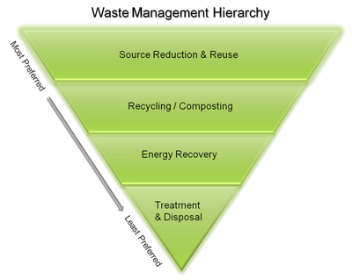
Solid waste
The EPA’s preferred method tree:

Slide 4
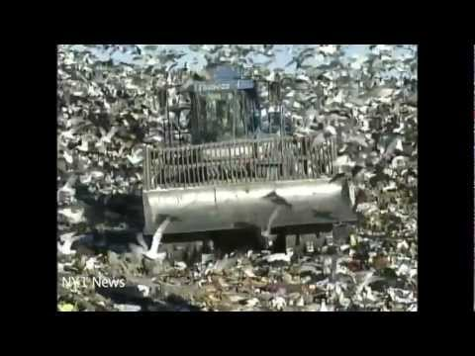
Solid waste
55 minutes

Slide 5
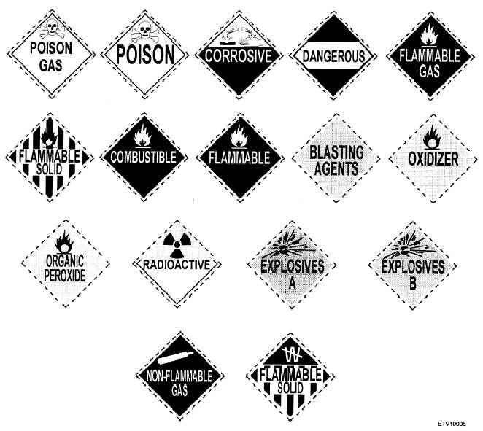
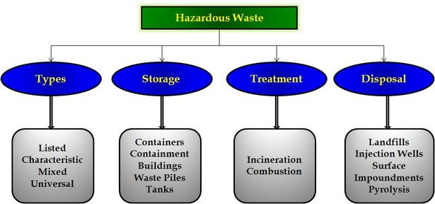
Hazardous waste

Slide 6
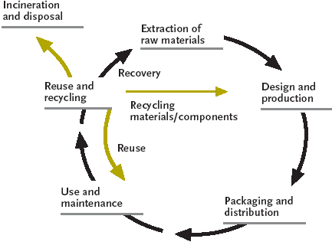
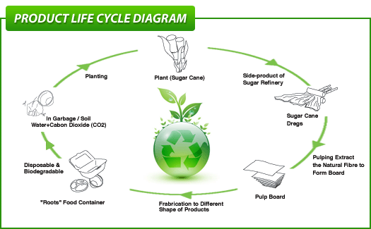
Product lifecycles

Slide 7
Connect it
What areas of law enforcement generate lots of excess waste? How can you (and your future team) cut back?
Do you need to innovate anything that will do the job for you?

