Slide 1
“Non-Renewable” Energy
Unit 8

Slide 2
First a few notes...
The reality is not as simple as the book makes it.
The “renewable-ness” is tied in with the efficiency of the engineering.
Recycling IS possible (and they are working out the details)

Slide 3
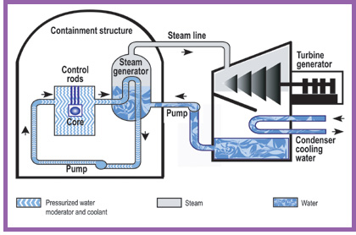
Production to consumption
454, figure 15.4 (coal)
Nuclear:

Slide 4
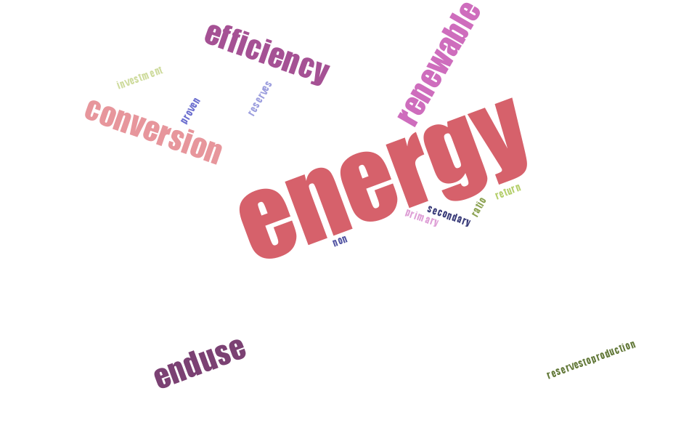
Vocab

Slide 5
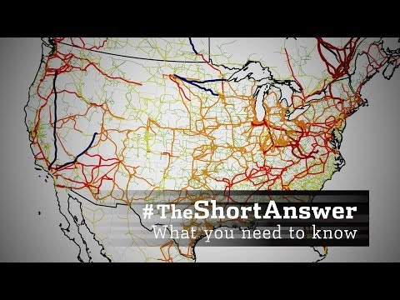
The Grid
While there is coal in Indiana, we don’t get ours here.
Instead, coal is delivered where ever it is
dug up from to a central “exchange”, which redistributes it as needed for a cost.

Slide 6
Think and connect
The connection between the grid and law enforcement isn’t immediately obvious, but give it some thought (in groups) and find the connection.

Slide 7
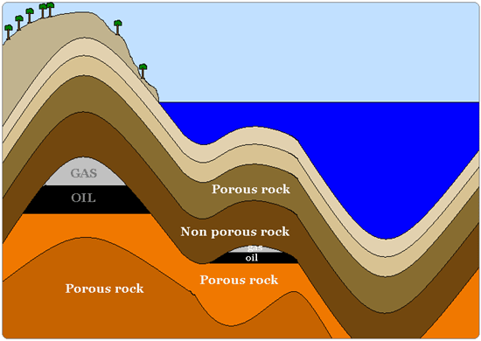
Oil & Gas

Slide 8
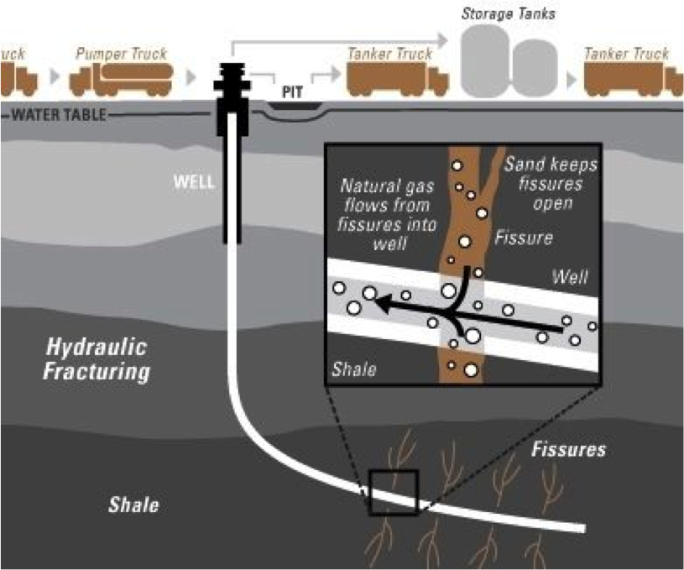
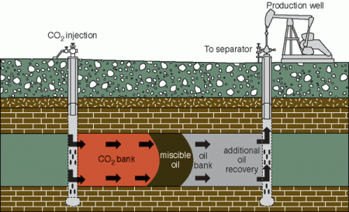
Fracking (not that evil)

Slide 9
Nuclear

Slide 10
Renewable (chp. 16)
Hint: Think of this as energy that seems like it will never end.

Slide 11
Engineering Woes
Unfamiliar technology (electric cars)
Scaling
Costs
Knowledge (for consumers)

Slide 12
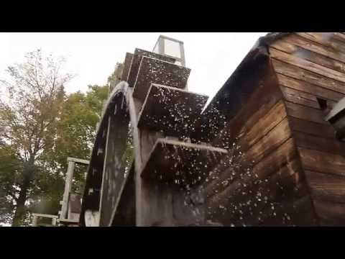
Hydropower

Slide 13
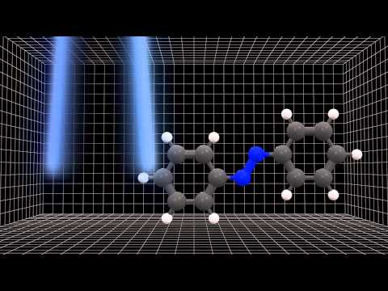
Solar energy

Slide 14
Wind Power
Wind power isn’t just for the plains.

Slide 15
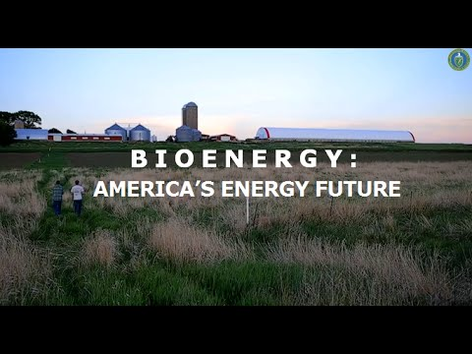
Bioenergy

Slide 16
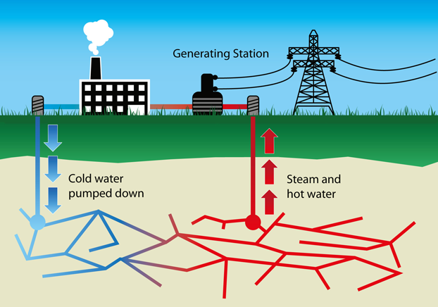
Tapping the earth

Slide 17
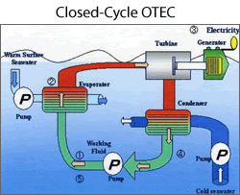
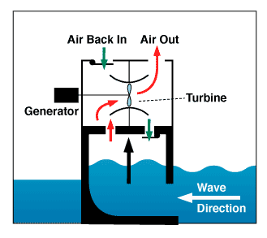
Riding Waves

Slide 18
Conserving & Connecting
Think deeply and practically about your future in law enforcement. Which of these renewable energies can be used now? In the short view of the future? Long term? Never?

